Slide 1
Introduction to JAVA

Slide 2
What is OOP?
Object-oriented programming (OOPs) is a methodology that simplifies software development and maintenance by providing some rules.

Slide 3
What is Java?
Java is a programming language and a platform. Java is a high level, robust, object-oriented and secure programming language.
Platform: Any hardware or software environment in which a program runs, is known as a platform. Since Java has a runtime environment (JRE) and API, it is called a platform.
Java was developed by Sun Microsystems in the year 1995. James Gosling is known as the father of Java. Before Java, its name was Oak. Since Oak was already a registered company, so James Gosling and his team changed the Oak name to Java.

Slide 4
Applications of Java
Desktop Applications
Web Applications
Enterprise Software
Mobile Applications
Games
Robotics
Embedded Systems etc.

Slide 5
Java Platform Editions
Java SE (Standard Edition)
Java EE (Enterprise Edition)
Java ME (Micro Edition)
JavaFX (for rich internet applications)

Slide 6
Features of JAVA
Simple
Object-Oriented
Portable
Platform independent
Secured (has own runtime environment) (JVM)
Robust (garbage collection, exception handling)
Architecture neutral
Interpreted
High Performance
Multithreaded
Distributed
Dynamic
https://www.javatpoint.com/features-of-java

Slide 7
Simple Program
class Test{
public static void main(String[]args){
System.out.println("Hello Java");
}
}

Slide 8
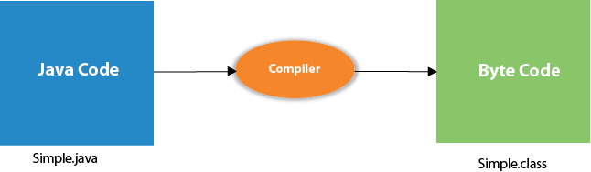
What happens to the code?
At compile time, java file is compiled by Java Compiler (It does not interact with OS) and converts the java code into bytecode.
The bytecode is then executed by the interpreter.

Slide 9
JVM
JVM (Java Virtual Machine) is an abstract machine. It is called a virtual machine because it doesn't physically exist. It is a specification that provides a runtime environment in which Java bytecode can be executed. It can also run those programs which are written in other languages and compiled to Java bytecode.
JVMs are available for many hardware and software platforms. JVM, JRE, and JDK are platform dependent because the configuration of each OS is different from each other. However, Java is platform independent.
The JVM performs the following main tasks:
Loads code
Verifies code
Executes code
Provides runtime environment

Slide 10
JRE
JRE is an acronym for Java Runtime Environment. It is also written as Java RTE. The Java Runtime Environment is a set of software tools which are used for developing Java applications. It is used to provide the runtime environment. It is the implementation of JVM. It physically exists. It contains a set of libraries + other files that JVM uses at runtime.
The implementation of JVM is also actively released by other companies besides Sun Micro Systems.

Slide 11
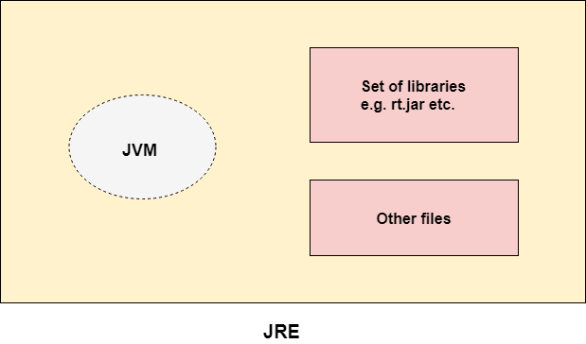
JRE

Slide 12
JDK
JDK is an acronym for Java Development Kit. The Java Development Kit (JDK) is a software development environment which is used to develop Java applications. It physically exists. It contains JRE + development tools.
JDK is an implementation of any one of the below given Java Platforms released by Oracle Corporation:
Standard Edition Java Platform
Enterprise Edition Java Platform
Micro Edition Java Platform
The JDK contains a private Java Virtual Machine (JVM) and a few other resources such as an interpreter/loader (java), a compiler (javac), an archiver (jar), a documentation generator (Javadoc), etc. to complete the development of a Java Application.

Slide 13
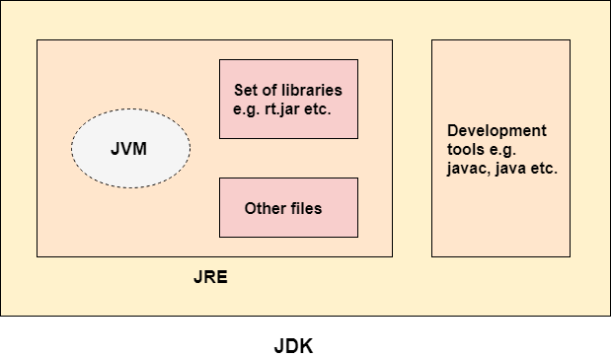
JDK

Slide 14
Data types in JAVA
Data types specify the different sizes and values that can be stored in the variable. There are two types of data types in Java:
Primitive data types: The primitive data types include boolean, char, byte, short, int, long, float and double.
Non-primitive data types: The non-primitive data types include Classes, Interfaces, and Arrays.

Slide 15
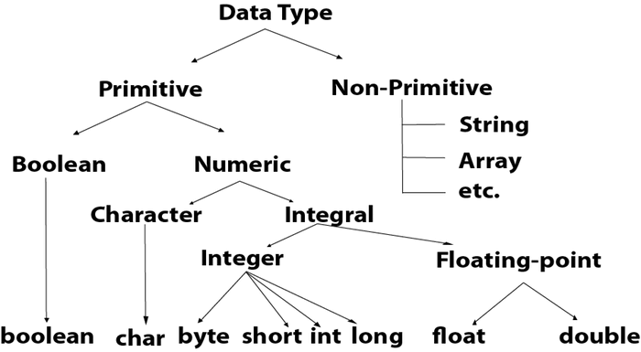

Slide 16
Primitive Data types
There are 8 types of primitive data types:
bollean data type
byte data type
char data type
short data type
int data type
long data type
float data type
double data type

Slide 17
Data Type | Default Value | Default size | Range
boolean | false | 1 bit | True/false
char | '\u0000' | 2 byte | 0 to 65,535
byte | 0 | 1 byte | -128 to 127
short | 0 | 2 byte | -32,768 to 32767
int | 0 | 4 byte | -2^31 to 2^31-1
long | 0L | 8 byte | -2^63 to 2^63-1
float | 0.0f | 4 byte | 6 to 7 decimal points
double | 0.0d | 8 byte | 15 to 16 decimal points

Slide 18
The operators, if-else, switch, loops, break and continue statements and arrays are same for java as for c.

Slide 19
Download Eclipse
JDK 1.8 (Standard Edition)
https://www.eclipse.org/downloads/

